Slide 1


PREDICTING SENTIMENT OF COVID 19 TWEETS
Capstone Project
AlmaBetter

Slide 2





•
•
•
•
•
Chinmay Rojatkar

Slide 3
CONTENT
Introduction.
Exploratory Data Analysis.
Data Pre-processing.
Vectorization.
Classification.
Evaluation.
Challenges.
Conclusion.
Q&A

Slide 4



PROBLEM STATEMENT
The challenge is to build a CLASSIFICATION MODEL to predict the sentiment of COVID-19 tweets. The tweets have been pulled from Twitter and manual tagging has been done then.
Location
Presentations are column that can be used for analysis
Tweet At
Original Tweet
Sentiment

Slide 5

Introduction
WE ARE ANALYZING DATA DURING PANDEMIC TIME TO GATHER CORRECT INFORMATION FOR MAKING POLICY FOR FURTHER USE
Sentiment Analysis is the process of computationally identifying and categorizing opinions expressed in a piece of text, especially in order to determine whether people attitude towards a particular topic is positive, negative, or neutral.
On 31st December, 2019 the Covid-19 outbreak was first reported in the Wuhan, Hubei Province, China and it started spreading rapidly all over the world. Finally, WHO announced Covid-19 outbreak as pandemic on 11th March, 2020, when the virus continues to spread.

Slide 6











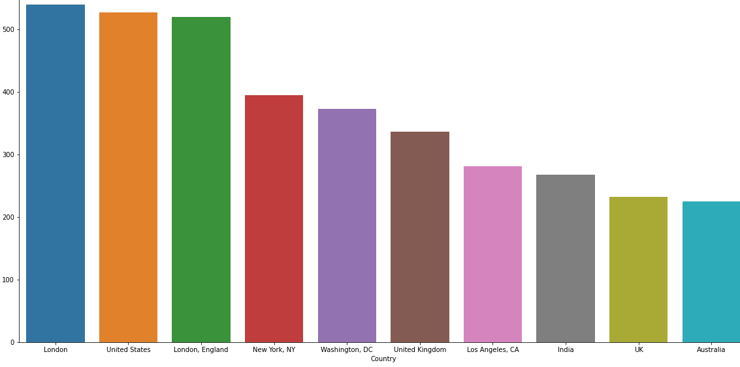






































Slide 7







Slide 8



R
The words which are generally filtered out before processing a natural language are called stop words. These
are actually the most common words in any language (like prepositions, pronouns, conjunctions, etc) and does not add much information to the text.
Stop words are available in
abundance in any human language. By removing these words, we remove
the low-level information from our text in order to give more focus to the important information.

Slide 9
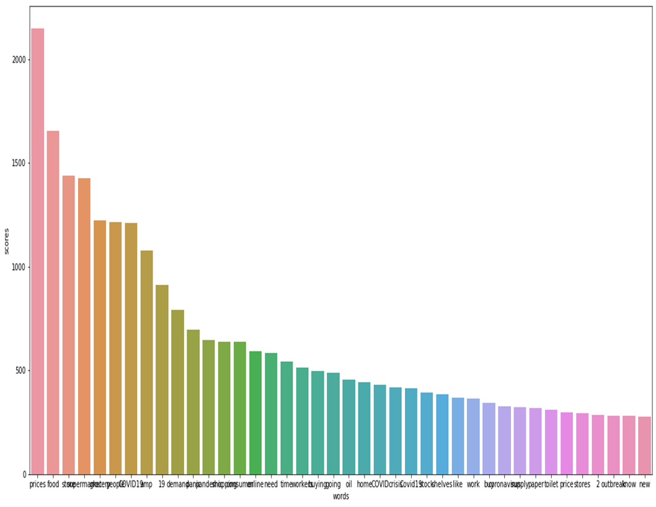
DATA SUMMARY
In order to analyses various sentiments, We require just two columns named Original Tweet and Sentiment
There are four types of sentiments- Extremely Negative, Negative, Neutral, Positive and Extremely Positive.
The original dataset has 6 columns and 41157 rows.

Slide 10
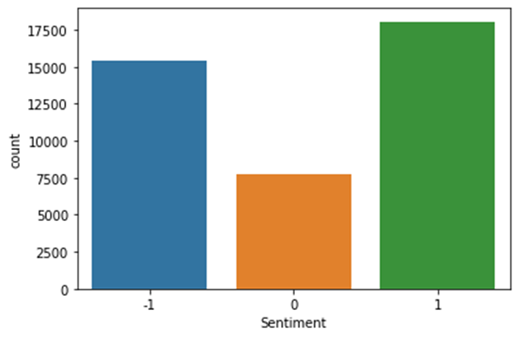
ONE HOT ENCODING
We have classified the tweets on the basis
the compound sentiments into two different classes, i.e.
Positive is (1), Negative (-1).
Then we have assigned the sentiment rating for each tweet based on the algorithm presented also shows in Graph.

Slide 11
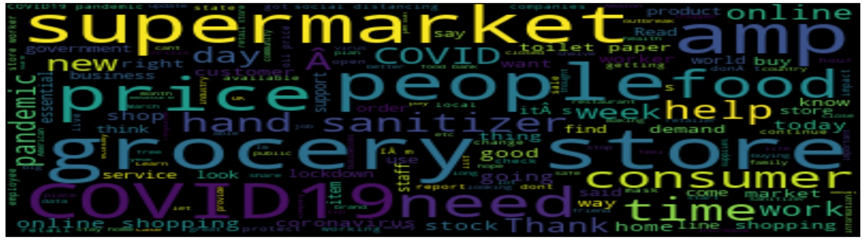


There are some words like ‘coronavirus’,’super market’, having the maximum frequency in our dataset.
There are various #hashtags in tweets column. But they are almost same
2

Slide 12



TOKENIZATION
In tokenization we convert group of sentence into token . It is also called text segmentation
It is basically splitting data into small chunk of words.
Tokenization in python can be done by python NLTK library’s word tokenize() function.

Slide 13
Spitting Our Dataset into Training And Testing Dataset
We need to split a dataset into train and test sets to evaluate how well our machine learning model performs. The train set is used to fit the model, and the statistics of the train set are known. The second set is called the test data set.

Slide 14

VECTORIZATION
We chose Count Vectorizer as our Vectorizer with minimum document frequency =10.
It will create a sparse matrix of all words and the number of times they are present in a document
Countvectorizerto transform a given text into a vector based on the frequency (count) of each word that occurs in the entire text.

Slide 15
Building Classification
Models
THERE ARE FIVE TYPES OF SENTIMENTS SO WE HAVE TO TRAIN OUR MODELS SO THAT THEY CAN GIVE US THE CORRECT LABEL FOR THE TEST DATASET. I AM GOING TO BUILT DIFFERENT MODELS LIKE NAIVE BAYES, LOGISTIC REGRESSION, RANDOM FOREST, XGBOOST, SUPPORT VECTOR MACHINES AND STOCHASTIC GRADIENT DESCENT.

Slide 16
Classification
ML MODELS
2
4
5
1
RANDOM FOREST CLASSIFIER FOR BINARY CLASSIFICATION
3
XG BOOST BINARY CLASSIFICATION
Stochastic Gradient Descent-SGD Classifier BINARY CLASSIFICATION
5
Naive Bayes Classifier for MULTICLASS
Classification
LOGISTIC REGRESSION BINARY CLASSIFICATION)
SUPPORT VECTOR MACHINE(BINARY CLASSIFICATION)

Slide 17
81.11%
Training Accuracy
NAIVE BAYES CLASSIFIER FOR MULTICLASS CLASSIFICATION
67.37%
Validation accuracy

Slide 18
99.9%
Training Accuracy
RANDOM FOREST CLASSIFIER FOR BINARY CLASSIFICATION
78.30%
Validation accuracy

Slide 19
97.14%
Training Accuracy
LOGISTIC REGRESSION BINARY CLASSIFICATION
81.82%
Validation accuracy

Slide 20
61.11%
Training Accuracy
XG BOOST BINARY CLASSIFICATION
78.30%
Validation accuracy

Slide 21
94.85%
Training Accuracy
SUPPORT VECTOR MACHINE(BINARY CLASSIFICATION)
78.74%
Validation accuracy

Slide 22
95.16%
WINNING MODEL
Training Accuracy
STOCHASTIC GRADIENT DESCENT-SGD CLASSIFIER( BINARY CLASSIFICATION)
83.62%
Validation accuracy

Slide 23

Conclusion
We focused on sentiment analysis for sentence labelling.
We described the preprocessing steps, and pipeline steps
within which text normalization and model validation is included, and performance has
cross- been
measured using balanced accuracy, f1 score etc. We used “Stemming” instead of Lemmatization to reduce dimensions, for the same reason we haven’t tried tf-idf or term frequency vectorizer. We concentrated on feeding our model with word count information. We assume, in the case of binary classification, we can further improve this score.

Slide 24



